Slide 1
UBER REVIEWS SENTIMENTAL ANALYSIS
Vamshi Reddy Komatireddy
Atharva Kousadikar
Harsh shindhwa
Rajani jangiti
Apoorva anumalla

Slide 2
CONTENTS
Why analysis of reviews?
About the dataset
Data Cleaning
Logistic Regression
Code
What can be done to improve accuracy?

Slide 3
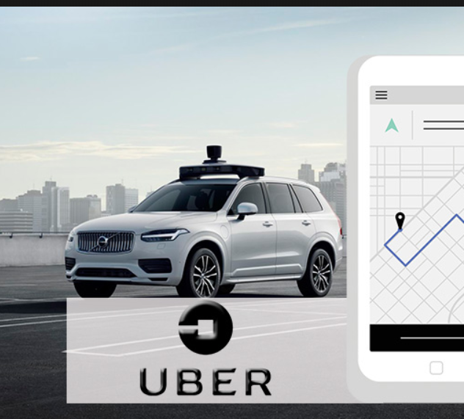
Do you guys take UBER rides often?
If YES, do you make sure to leave them ratings and reviews?
Well, our project talks about analyzing the reviews and feedbacks from the customer.

Slide 4

Why analysis of reviews?
It is a wonderful opportunity for the company to know the feedback of the customer which in turn helps in knowing their flaws and working on getting better.
Quality of service can be improved by encouraging the drivers with good ratings.

Slide 5
About the Dataset
We chose the Uber Text Reviews dataset openly available on https://towardsdatascience.com/uber-reviews-text-analysis-11613675046d
There are 3 columns in this dataset.
Ride_review
Ride_rating (on a scale of 1 to 5)
Sentiment (binary)
If the rating is 1 or 2 implies that the sentiment is 0.
If the rating is 4 or 5 implies that the sentiment is 1.

Slide 6
Cleaning the Data
The first and the most important task is to clean the data. Cleaning the data ensures better accuracy and better prediction.
We begin with eliminating the rows which has ride_rating = 3. With compromised rating, the accuracy falls at a great rate and does not serve us any good purpose.
Next, we create a set of commonly used words, eliminate them from the review column and save them in new column for future use.
Further, we apply tokenization to the cleaned column. It creates tokens to each word in the text.

Slide 7
Applying Logistic Regression..
To apply any model, we begin with splitting the data into Training data and Testing data.
Usually, 70% of the data is the training data and 30% is the testing data.
The training data is used to train the model and the model is tested using the testing data.
We declare the features using the CountVectorizer function
We apply the Logistic Regression model and fit it with the training data.
Once the data is trained, we test it by giving the testing data as input.

Slide 8
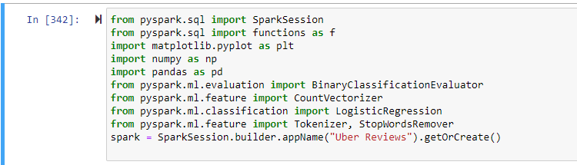
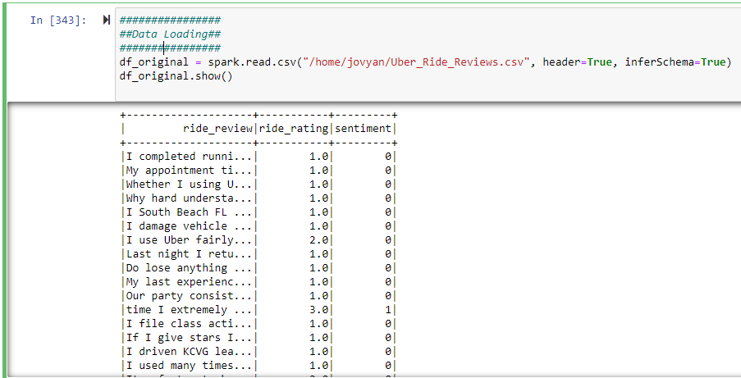
Snippets of code
Importing the required libraries from pyspark.
Loading the data from a csv file.

Slide 9

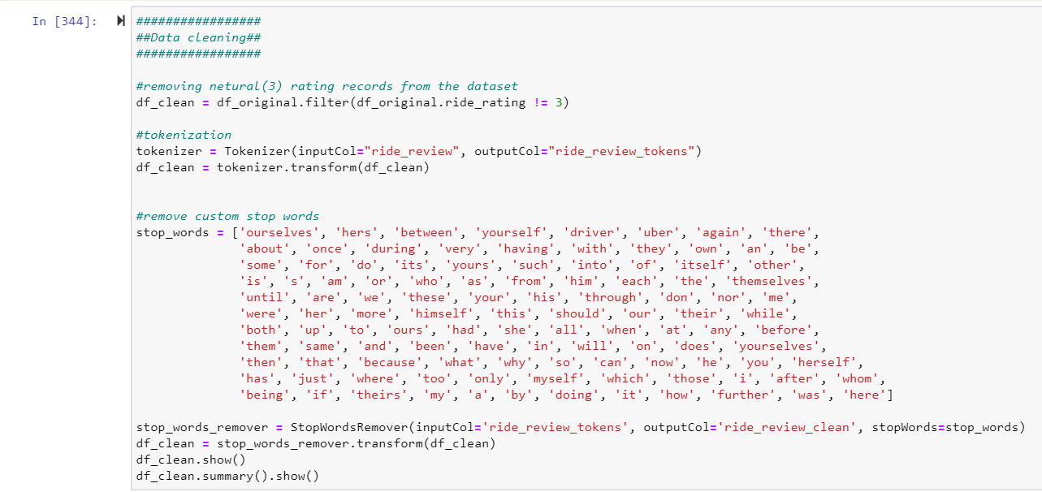
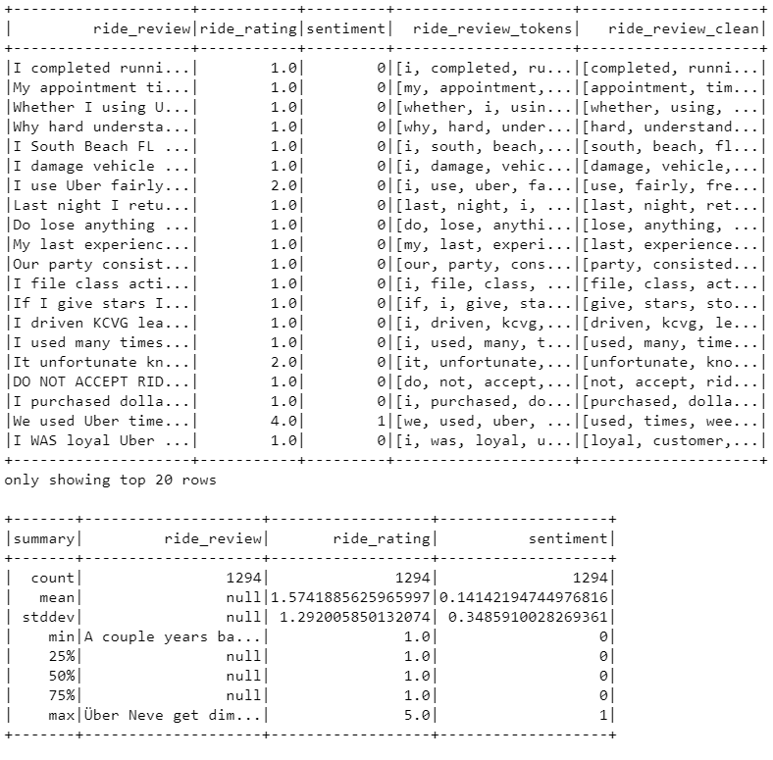
Data cleaning and output.

Slide 10
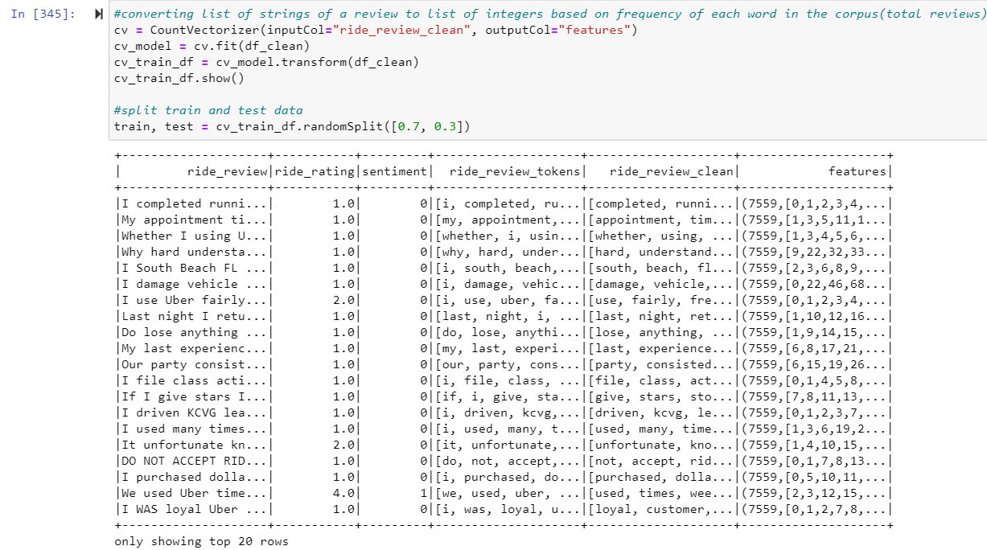
Text modification into numbers based on the frequency of their occurrence.

Slide 11
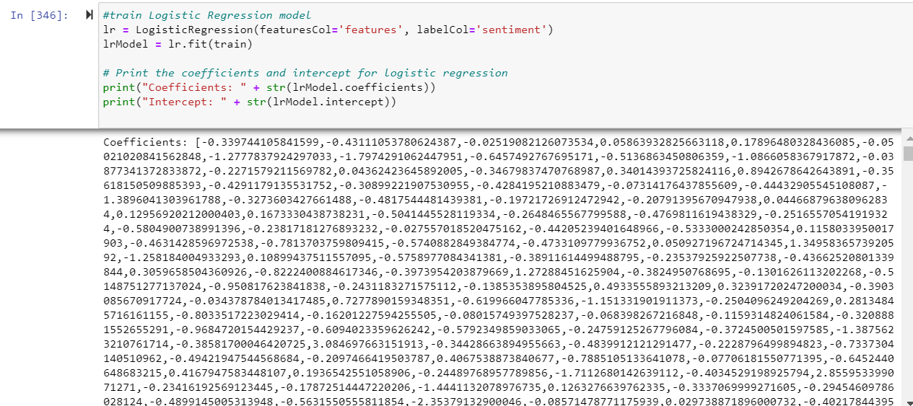
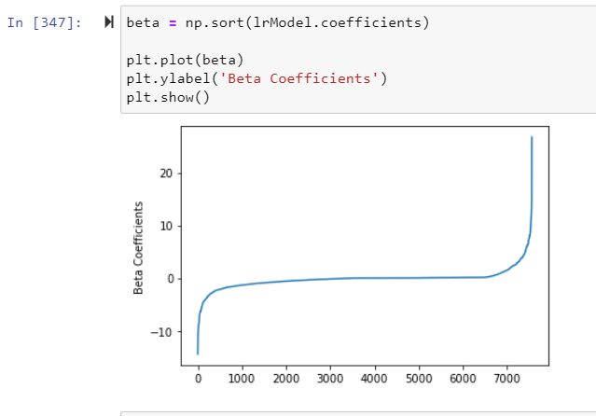
Training the logistic regression model and printing coefficients & intercepts.

Slide 12
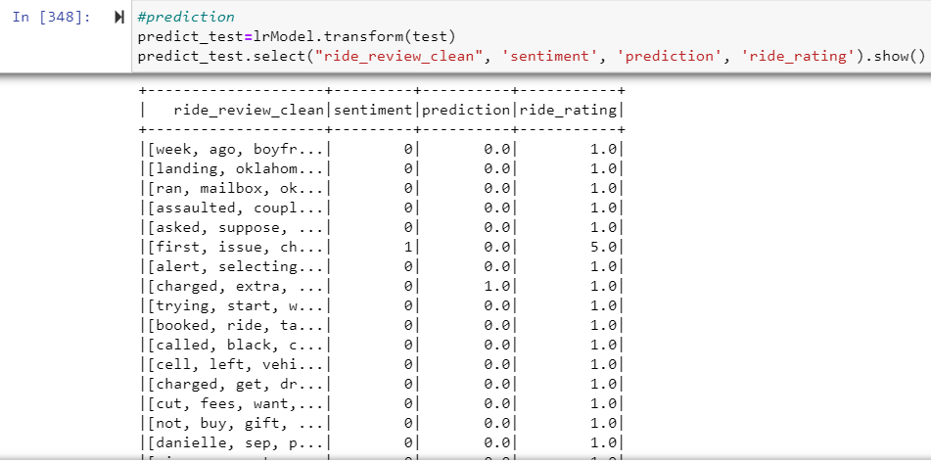
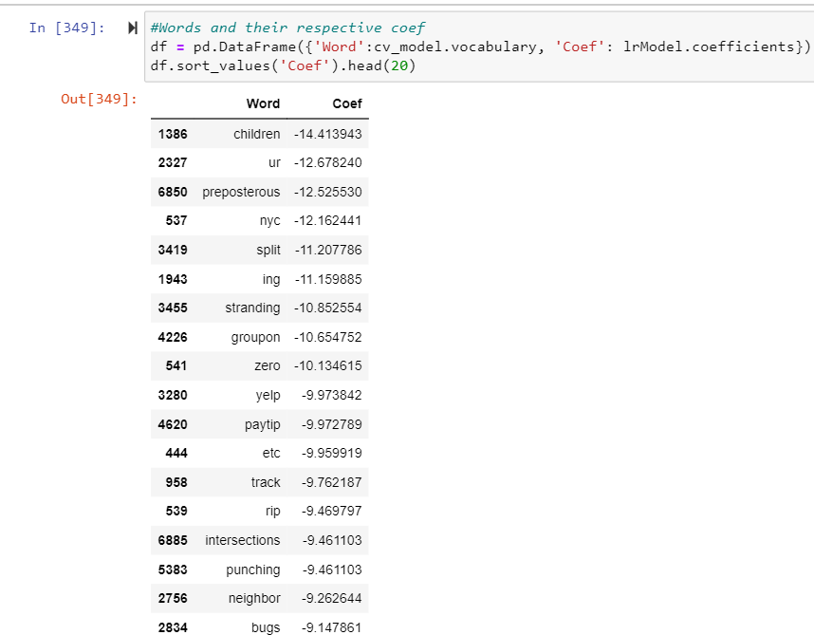
Prediction using test data and printing words against their coeff.

Slide 13
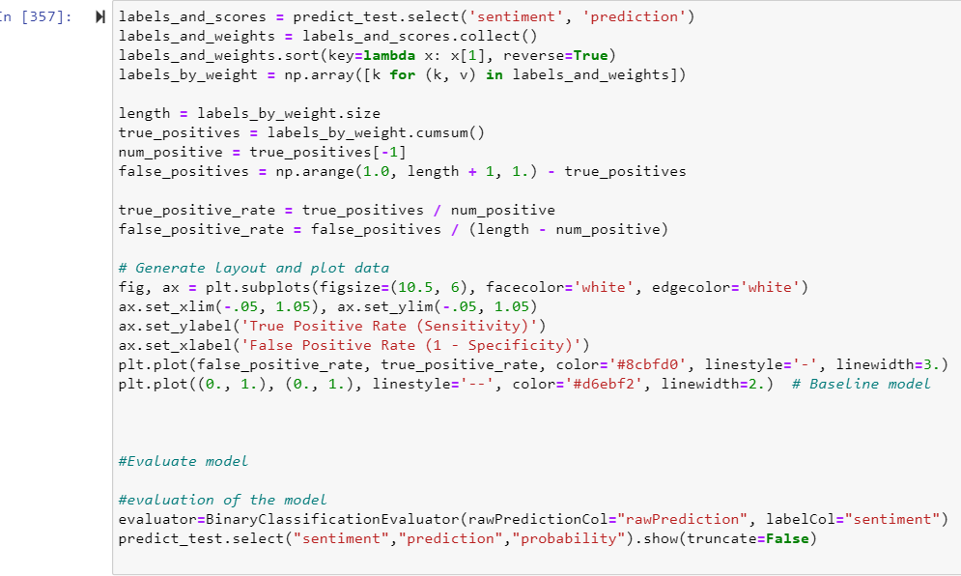
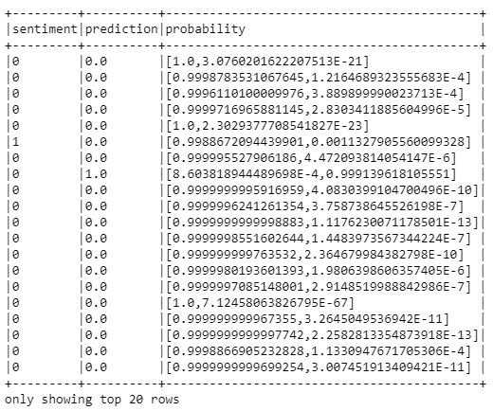
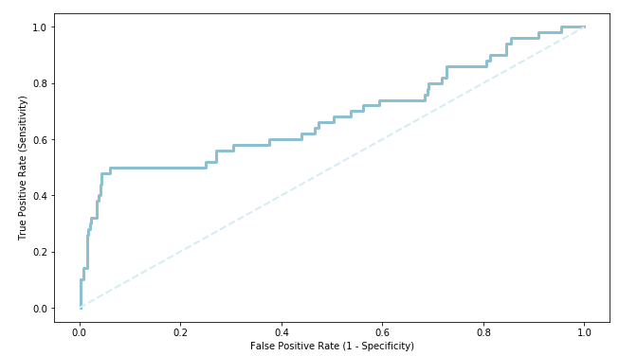
Evaluating the model.

Slide 14
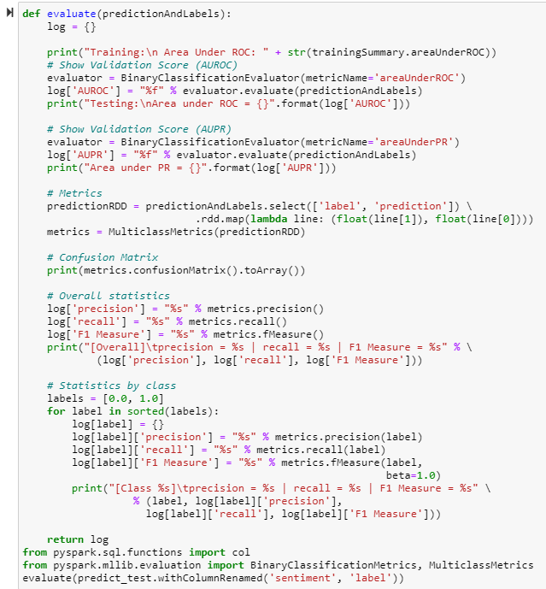
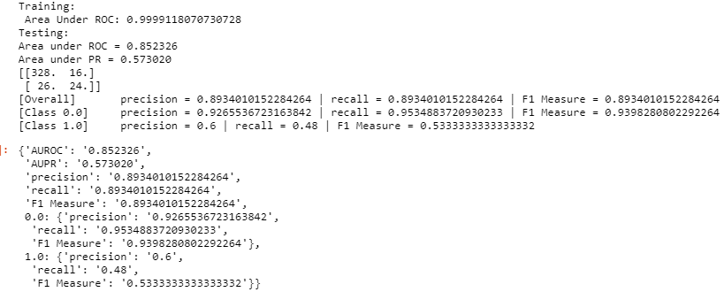

Slide 15
What can be done to improve accuracy?
In our project, we have utilized unigrams where single words will be considered and judged to be either good or bad.
For instance, we have a reviews “The ride was not good at all”. Here, good falls under the positive review category. However, as it is preceded by a negative word ‘not’ changes the meaning totally.
In such cases, performing analysis using bigram or trigram should be of great help.

Slide 16


